Slide 1
How do we analyze data?

Slide 2
How do we analyze data?
Hadley Wickham and the “Grammar” of Data Analysis

Slide 3
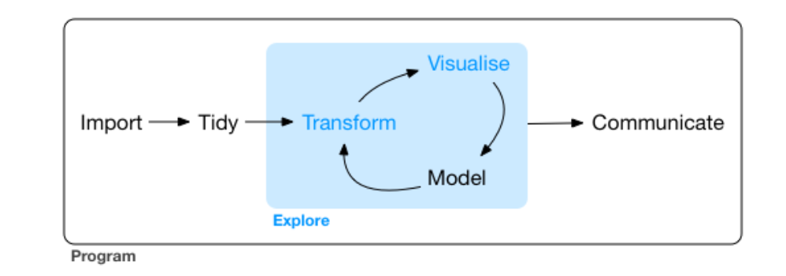
Data Analysis Workflow
https://r4ds.had.co.nz/explore-intro.html

Slide 4

https://www.tidyverse.org/images/hex-tidyverse.png

Slide 5
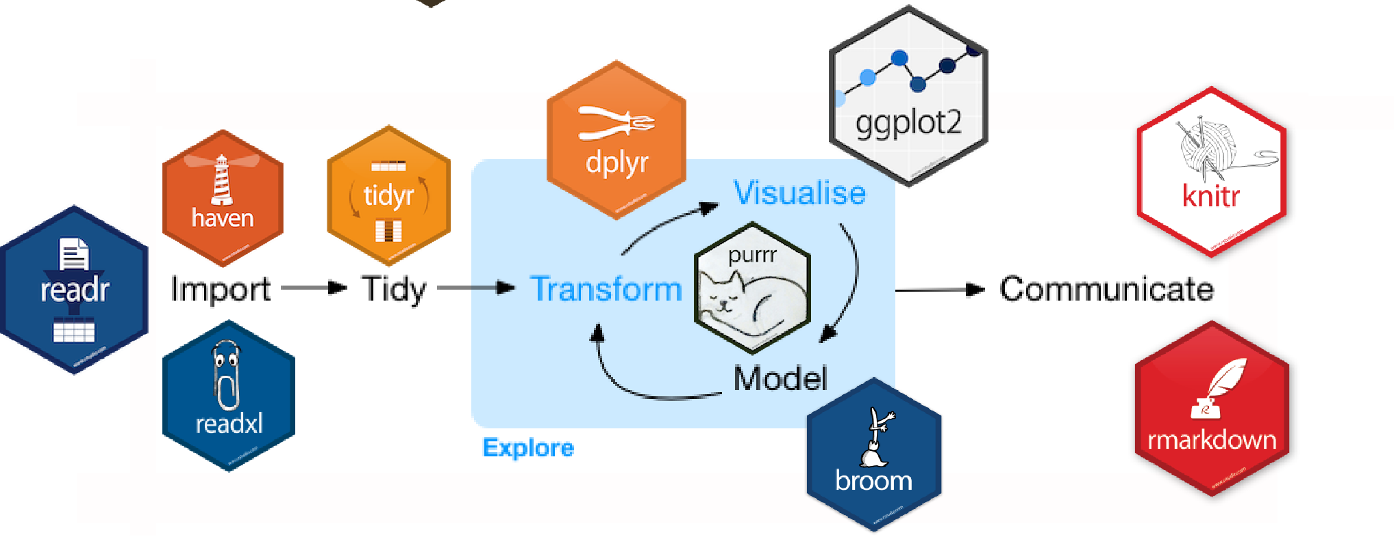
The Tidyverse
https://beanumber.github.io/tidy-databases/tidy_databases_slides.html#section

Slide 6
Getting started with Tidyverse

Slide 7
The grammar of graphics

Slide 8
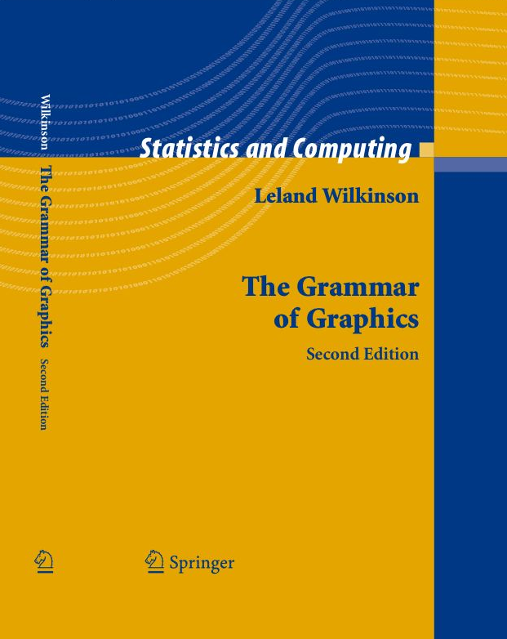
The Grammar of Graphics
A structured language for plotting
All plots follow this language
Key components:
Data
Aesthetics
Geometries
Facets
Statistics
Coordinates
Theme
https://www.cs.uic.edu/~wilkinson/TheGrammarOfGraphics/gog2.jpg

Slide 9
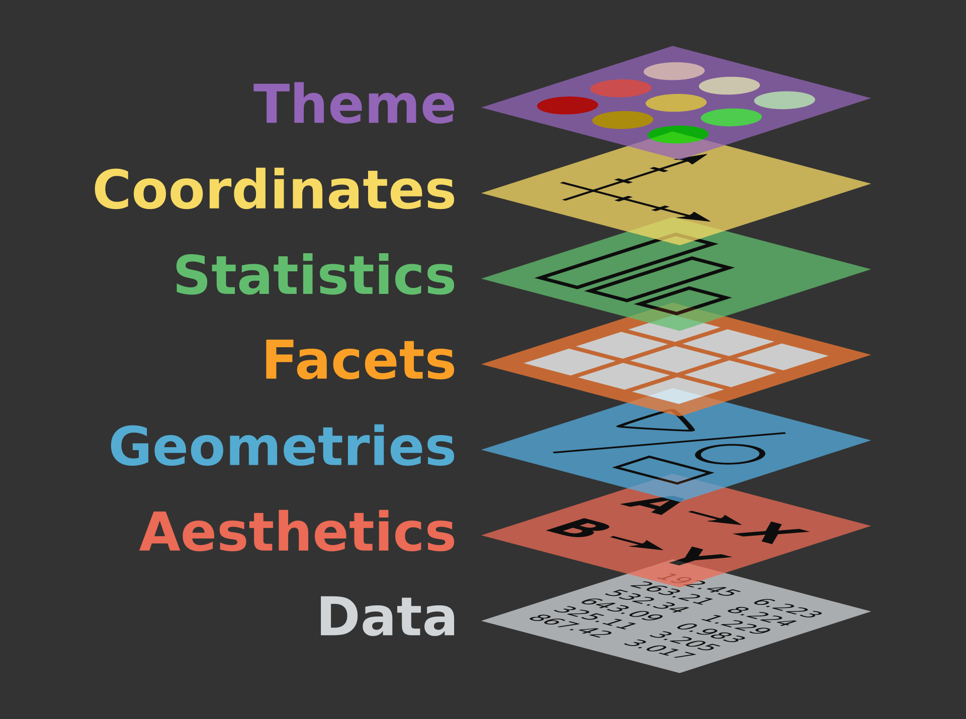
https://ggplot2.tidyverse.org/reference/index.html
Source: https://www.catallaxyservices.com/media/Grammar-Of-Graphics/#/3/3

Slide 10
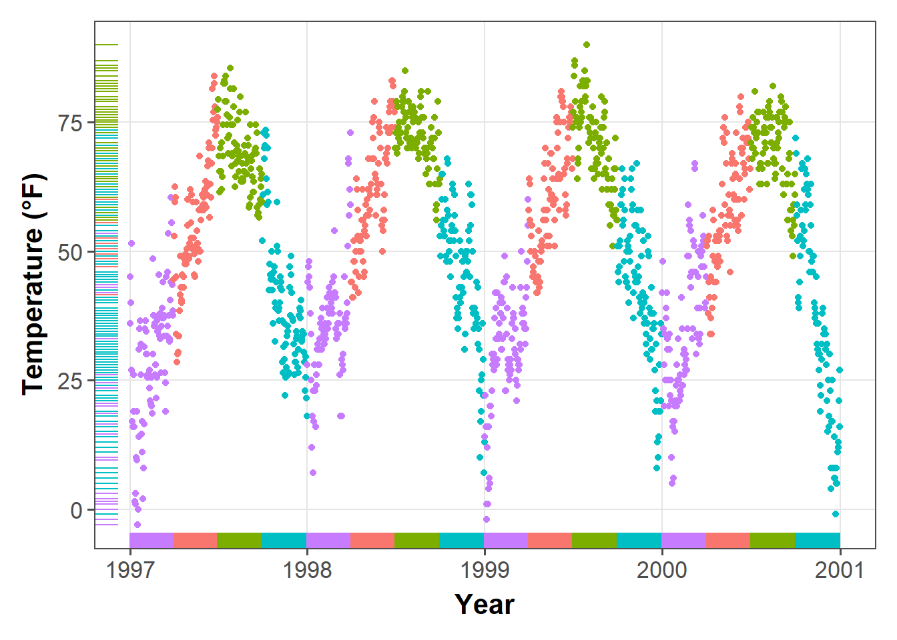
ggplot2: elegant plots using the grammar of graphics
https://d33wubrfki0l68.cloudfront.net/b6c4ce171dc7d21658771efb445b7b24b6850755/afafc/post/2019-08-05_ggplot2-tutorial_files/figure-html/rug-1.png

Slide 11
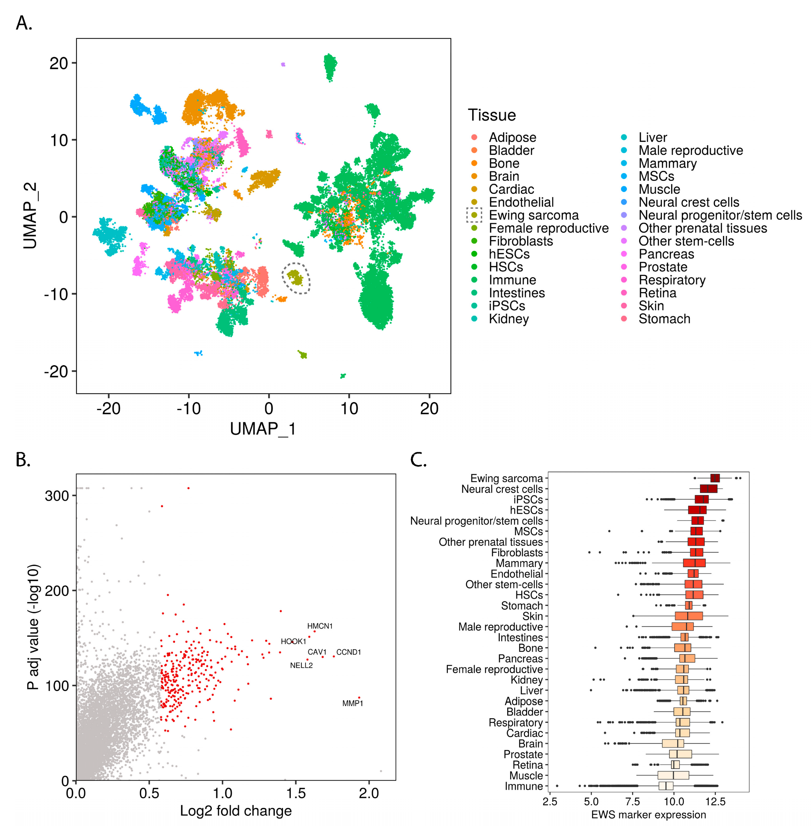
ggplot2: elegant plots using the grammar of graphics

